Slide 1
Career Trajectories Analysis
Exploring salary patterns and experience across global industries through comprehensive data analysis
Name: REONA P
Batch: AUGUEST-2025
DATE: 23-01-2026

Slide 2




PROJECT OVERVIEW
Understanding the Dataset
Demographics
Age range, gender, and location data across countries, states, and cities
Professional Details
Industry, job title, years of experience overall and in field
Compensation
Annual salary, additional monetary compensation, and currency information
Education
Highest level of education completed by each individual

Slide 3

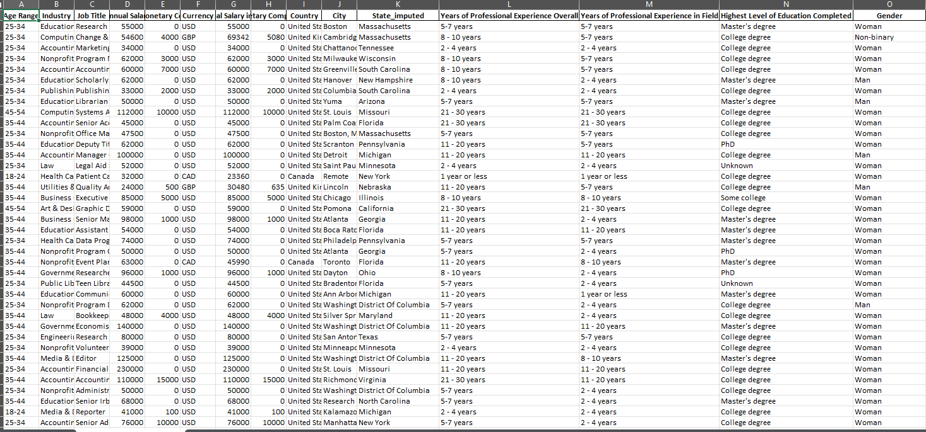
Data Cleaning & Preprocessing
01
Handle Missing Values
Final Output
Fill numerical columns with mean/median or remove rows; replace categorical missing values with "Unknown"
Cleaned dataset ready for MySQL import and analysis
02
Standardize Data Types
Ensure appropriate data types for all columns
03
Fix Inconsistencies
Standardize spelling, formats, and capitalization across categorical values
04
Check for Outliers
Identify and handle outliers in salary data based on domain knowledge

Slide 4
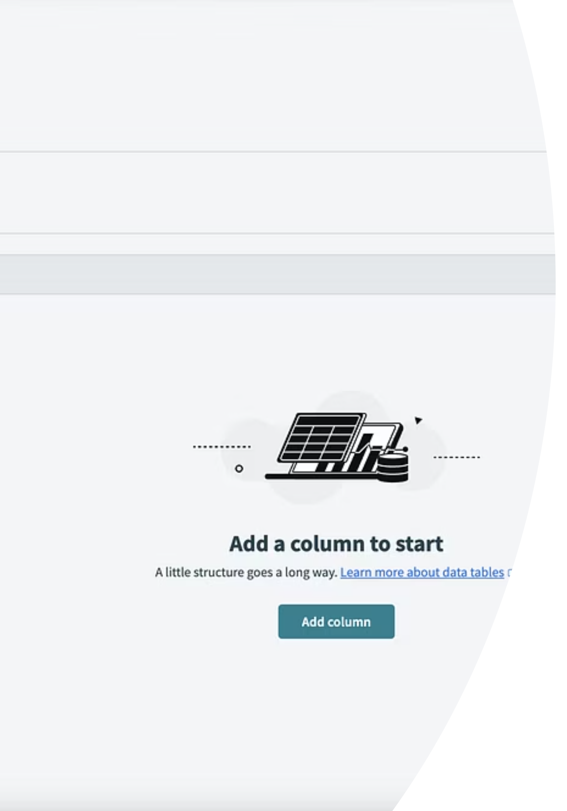

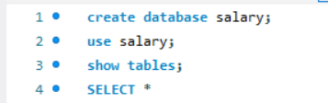

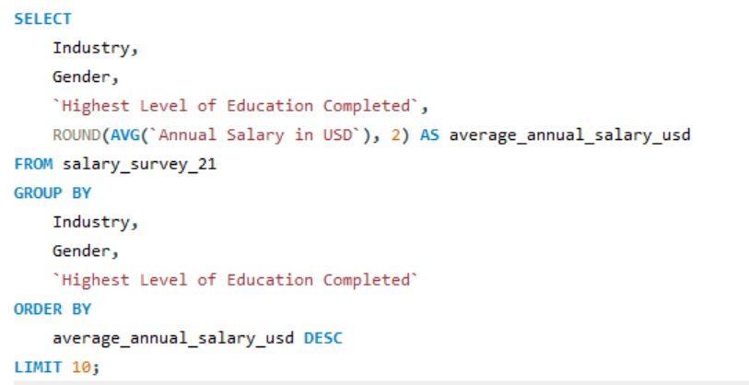

MySQL Database Setup
Create Database
Open MySQL Workbench and create new database
Design Table
Create table with appropriate column names and data types
Import Data
Load cleaned CSV data using LOAD DATA command or import tools

Slide 5
Key SQL Queries for Analysis
Average Salary by Industry & Gender
1
Identify potential salary discrepancies based on gender within industries
Total Compensation by Job Title
2
Calculate base salary plus additional compensation for each role
Salary Distribution by Education
3
Analyze correlation between education level and salary (average, min, max)
Employees by Industry & Experience
4
Determine workforce distribution across industries by years of experience
Median Salary by Age & Gender
5
Reveal salary trends across different age groups and gender

Slide 6
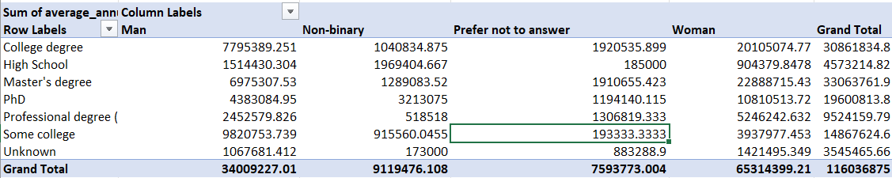
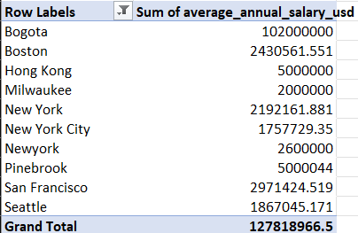
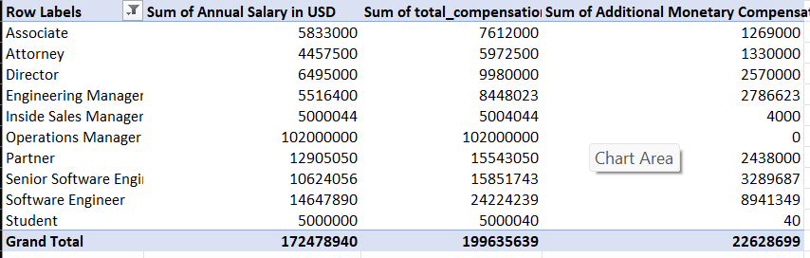
Advanced Query Insights
Highest Salaries by Country
Bonus Compensation Patterns
Identify top-paying job titles in each country to understand global salary trends
Percentage of employees receiving additional compensation by gender
City & Industry Averages
Experience-Based Compensation
Calculate average salary for each city-industry combination
Total compensation trends by job title and years of experience

Slide 7
Excel Data Organization
1
Export from MySQL
Run each SQL query and export results to CSV files
2
Create Workbook
Open Excel and create new workbook with dedicated sheets
3
Import Data
Import each CSV file into separate sheet (10 sheets total)
4
Organize Structure
Label sheets clearly for each query result

Slide 8
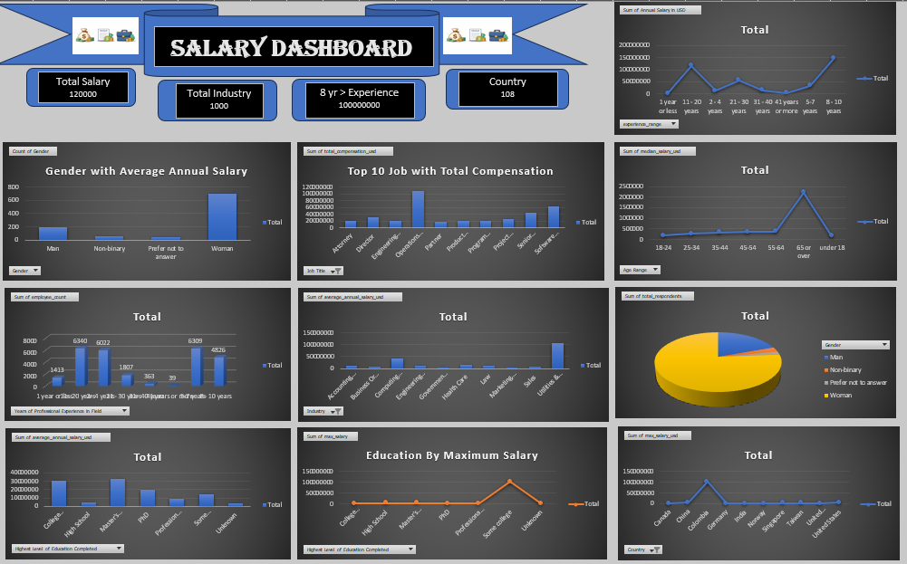



Dashboard Creation Process
Build Pivot Tables
Create pivot tables from each sheet to summarize key metrics using appropriate fields
Design Visualizations
Use bar charts, pie charts, and line charts to visualize salary distribution, gender patterns, and top-paying roles
Assemble Dashboard
Arrange charts on dedicated dashboard sheet with clear labels, titles, and legends

Slide 9
THANK YOU
.

